Slide 1
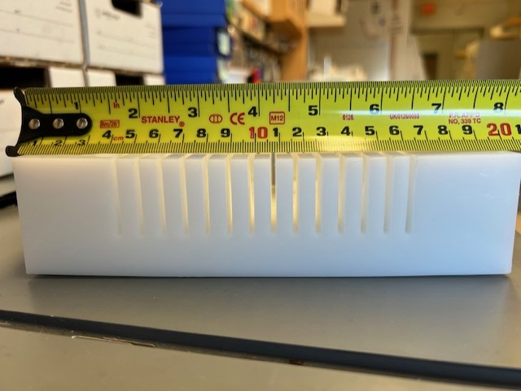
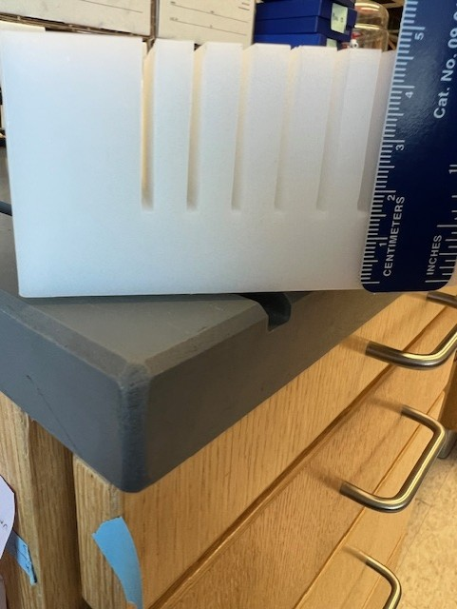
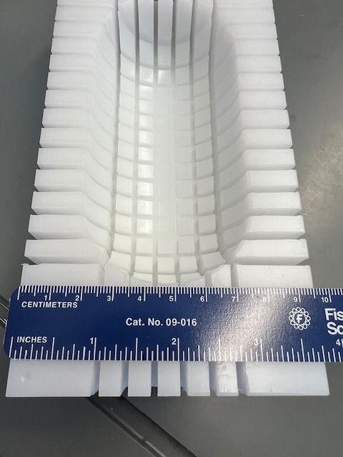
Total Length of Block: 19.5 cm
Total Width of Block: 9.5 cm
Total Height of Block: 9.5 cm

Slide 2
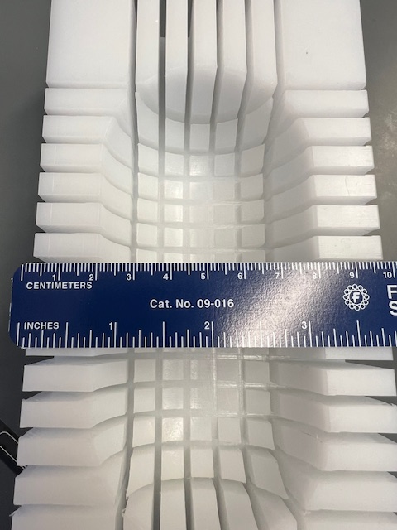
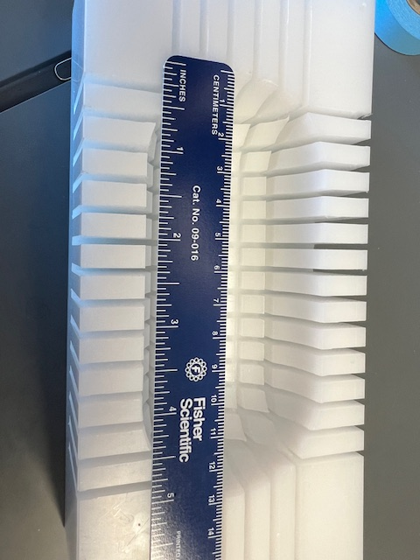
Length of Kidney area: 13 cm
Width of Kidney area: 6 cm

Slide 3
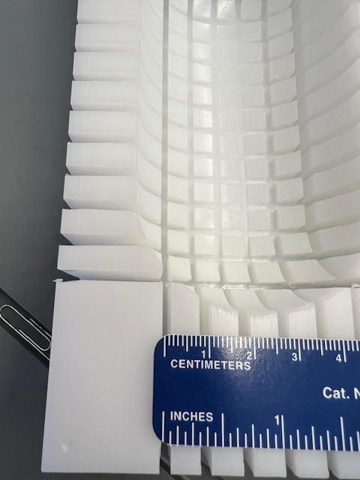
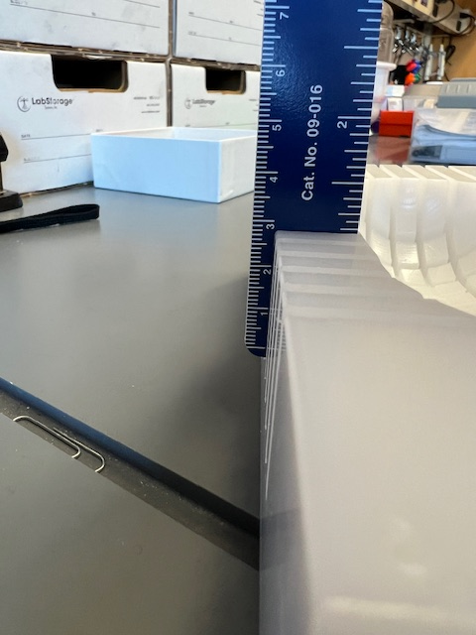
Cutting notch: 3 cm
“Block” size: 5 cm
Cutting Depth: 3 cm

